Slide 1
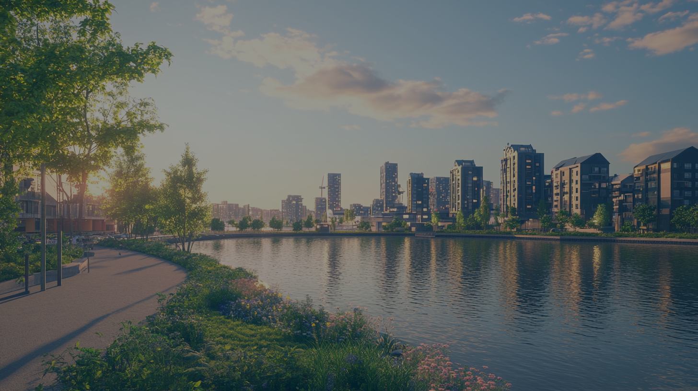
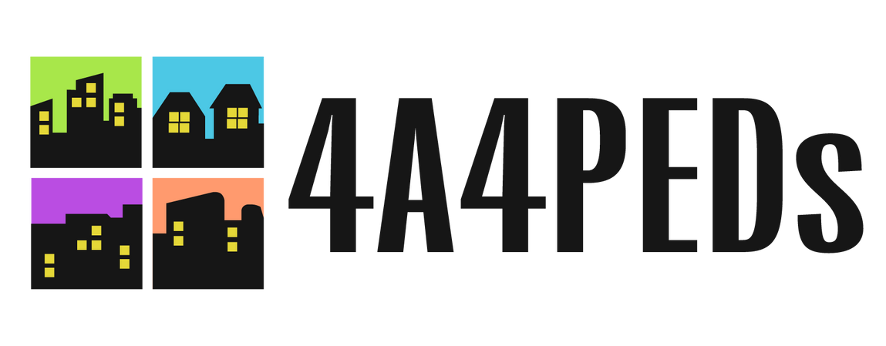



Slide 2
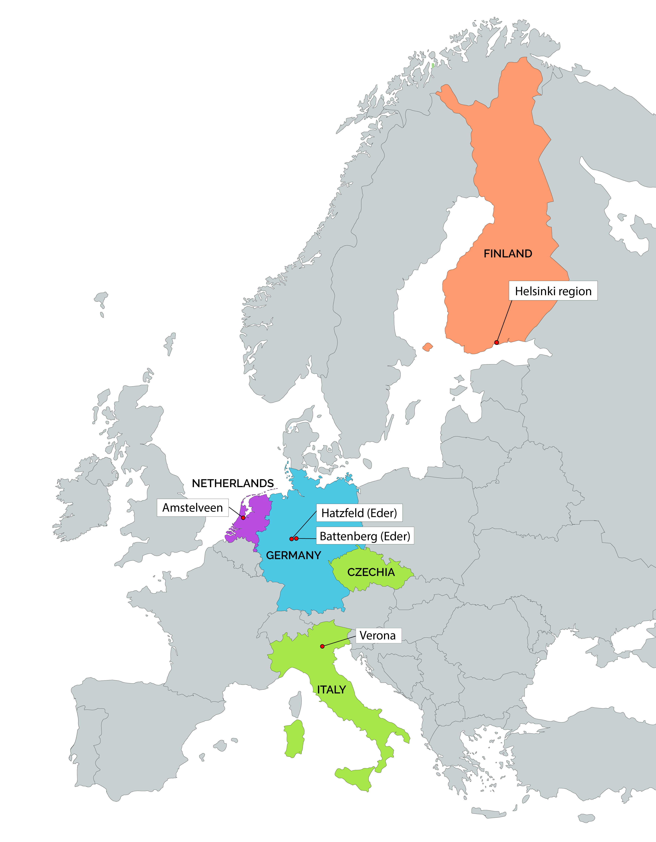
Finnish high-level expertise: Universities and higher education institutions as accelerators of the energy transition, exemplified by Positive Energy Districts (PEDs)
Finnish high-level expertise: Universities and higher education institutions as accelerators of the energy transition, exemplified by Positive Energy Districts (PEDs)

Slide 3
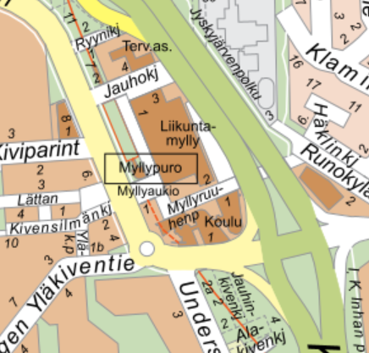
Why This Matters in Finland
Finland carbon neutrality target 2035
Cities leading climate action (Helsinki, Espoo, Tampere)
Campuses = major energy consumers & landowners
EPBD 2024 → shift toward district-level thinking

Slide 4
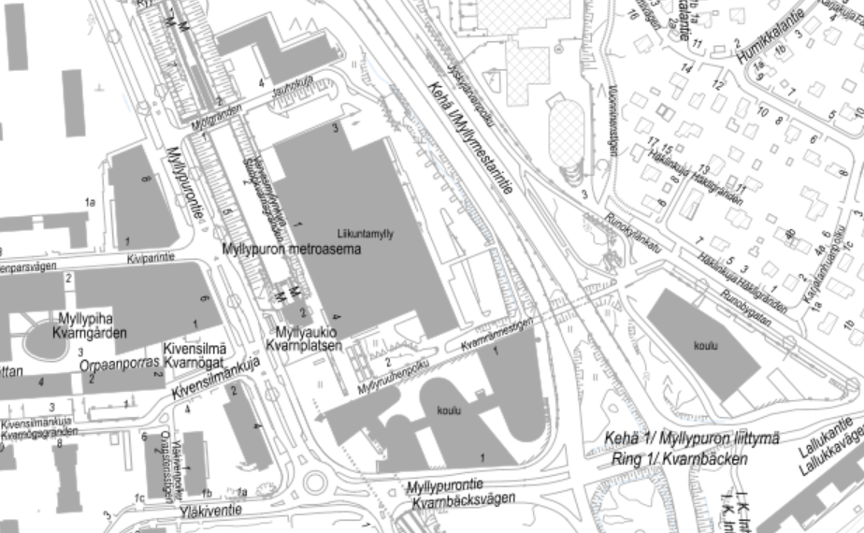
What Is a Positive Energy District (PED)?
District annually produces more renewable energy than it consumes
Energy efficiency first principle
Local renewables + storage + flexibility
Annual net-positive energy balance
Myllypuro Positive Energy District
Selected properties: education, health, and sports services (Metropolia, Stadin AO, Liikuntamylly).

Slide 5
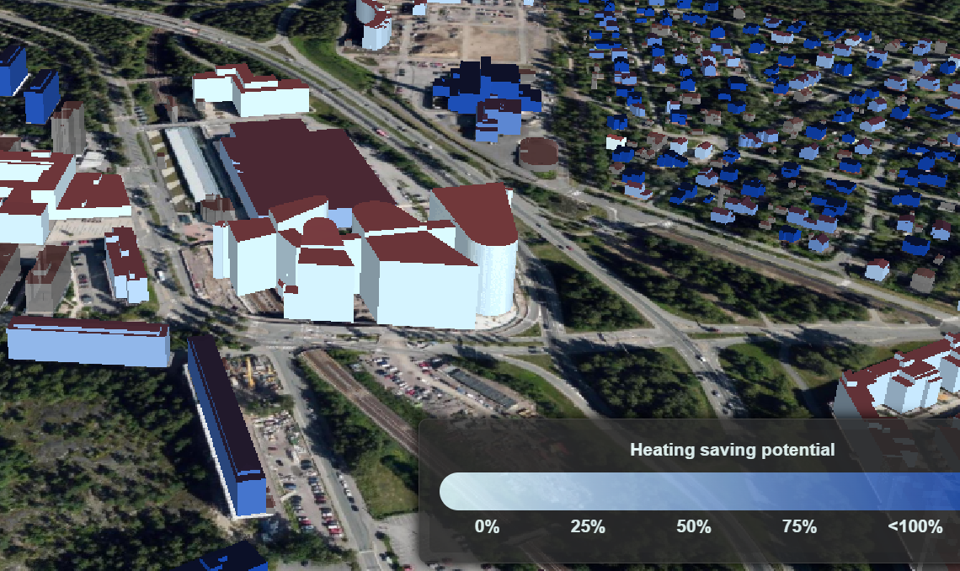
Why Campuses Are Ideal PED Testbeds
Defined geographic boundaries
Mixed-use buildings (labs, housing, services)
Strong digital & data infrastructure
Research + operations synergy
Heating saving potential map

Slide 6
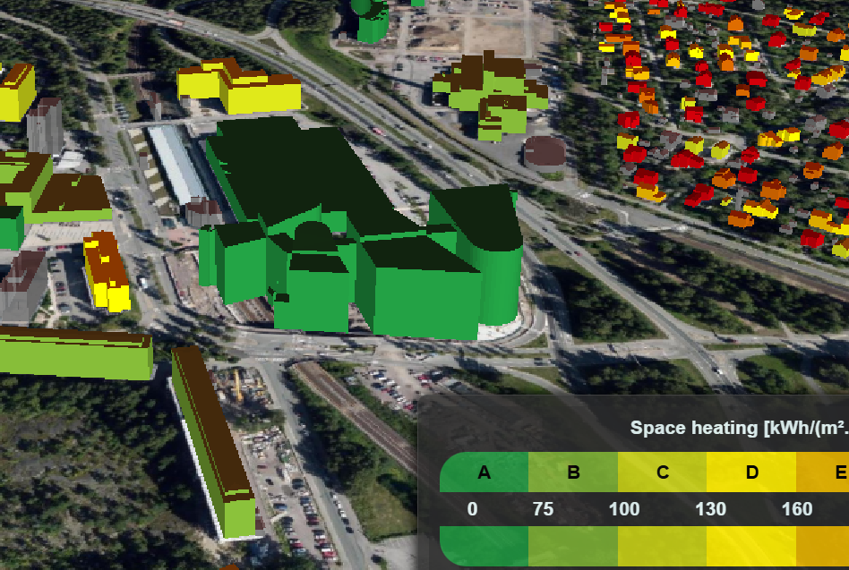
Finnish Campus Examples
space heating demand Myllypuro
Aalto University – Otaniemi innovation ecosystem
Tampere University – Hervanta smart energy systems
Metropolia UAS – Urban campus integration
Living lab pilots & monitoring systems
Space heating demand Myllypuro

Slide 7
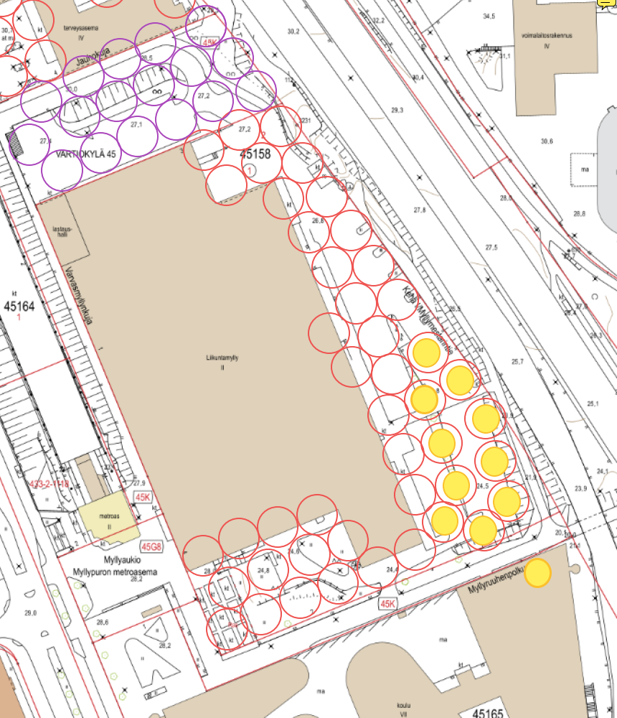
Higher Education Roles in PED Development
The circles in the image indicate the planned energy wells, with the existing ones shown in yellow.
Living labs for testing energy systems
Multidisciplinary competence building
City–industry–research collaboration platform
Influence via procurement & land allocation
The circles in the image indicate the planned energy wells, with the existing ones shown in yellow.

Slide 8
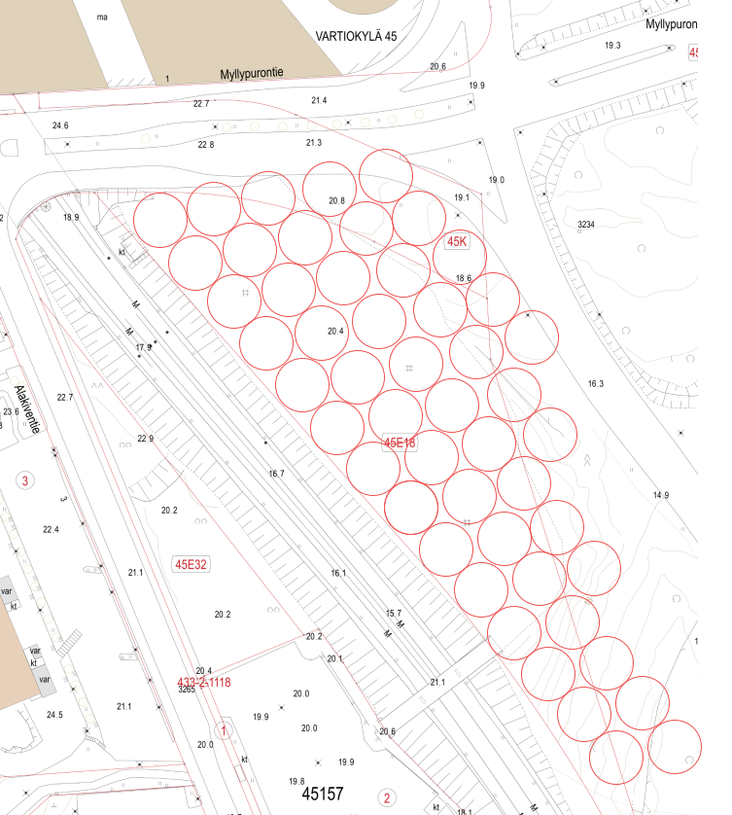
Campus → District → City Scaling
Pilot solutions on campus
Integration with surrounding urban districts
Energy communities & demand response
Building → Block → District → City logic
At the urban scale, we can consider utilizing available areas, such as parks, for renewable energy production.

Slide 9
Finnish-Specific Challenges
Cold climate & high heating demand
Existing district heating structures
Investment constraints
Building-focused regulation
An example of annual energy consumption in Finland.

Slide 10
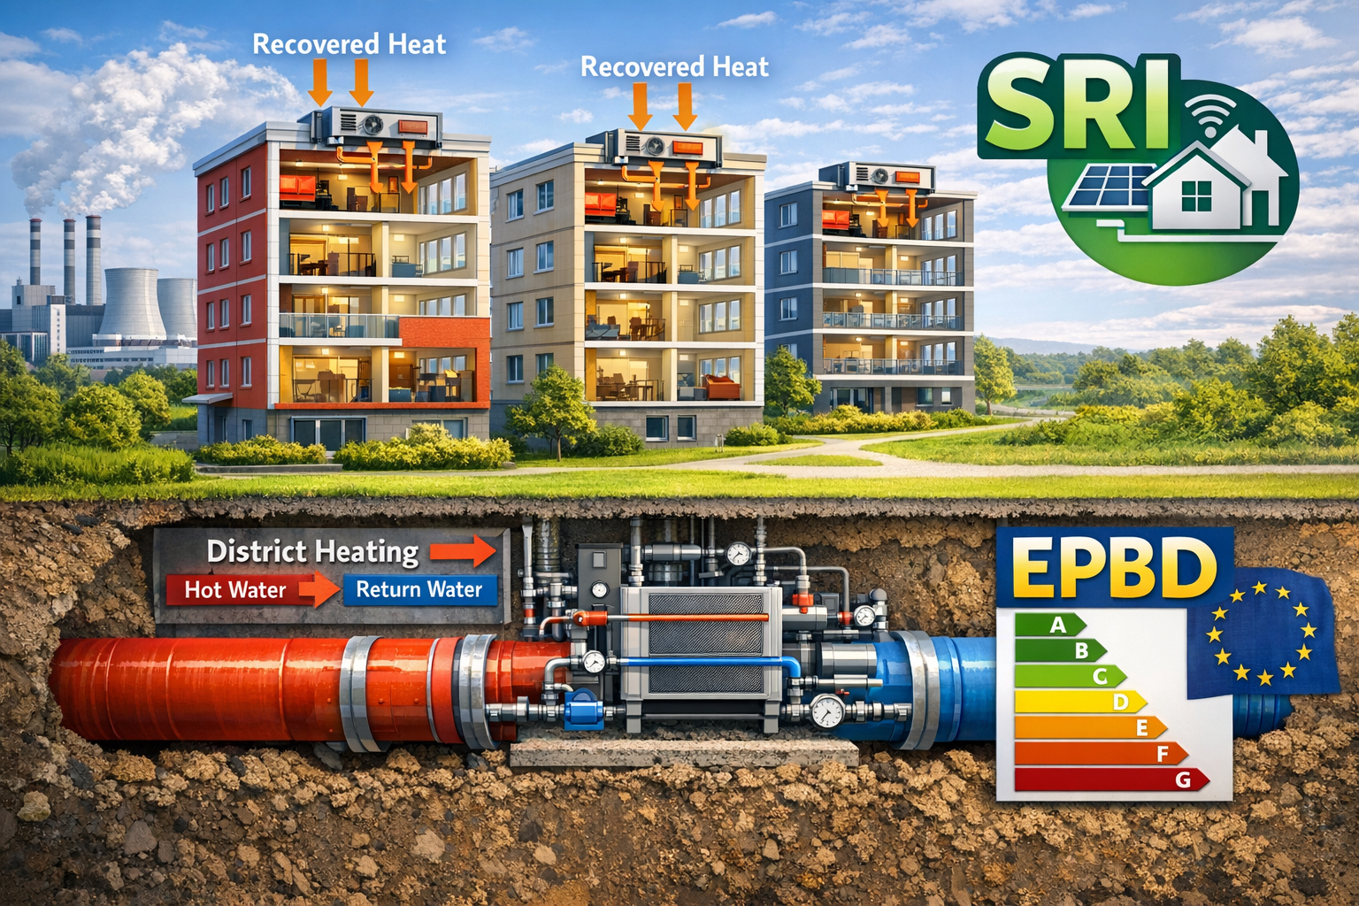
Strategic Opportunities
Waste heat utilisation
Hybrid energy systems
Energy-as-a-Service models
SRI & EPBD 2024 implementation

Slide 11

Key Takeaways
Universities are urban energy actors
Campuses can become PED pilots
Cross-sector collaboration is essential
Finland can lead in Nordic PED solutions

